Slide 1


HACK/ATHON
Team : IGNITERS

Slide 2
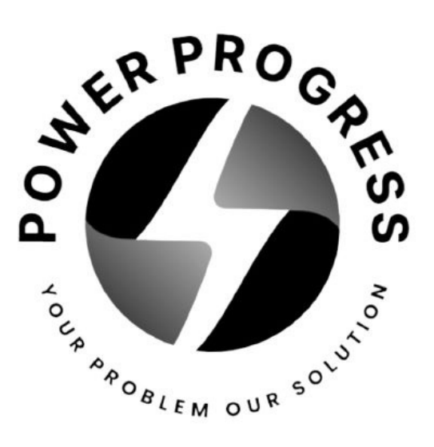


POWER PROGRESS

Slide 3
Executive Summary
Unique selling proposition
Product Description
Components of the Product
Key Features
Table of Content

Slide 4



Executive Summary
It's a wireless water sensor that maintains water flow between tanks without any kind of wiring involved in it.
The vision of this model is to provide safe and quick services where the customer can receive a quality product at a reasonable price.

Slide 5



Unique Selling Proposition
Low power consumption: Low power consumption leads to longer battery life, which results in greater user experience for customers due to the extended periods between battery changes. It has 5 year-long battery life.
Wireless technology: The wireless network does not require any cable or wires; hence, communication is possible even when the user is moving.

Slide 6
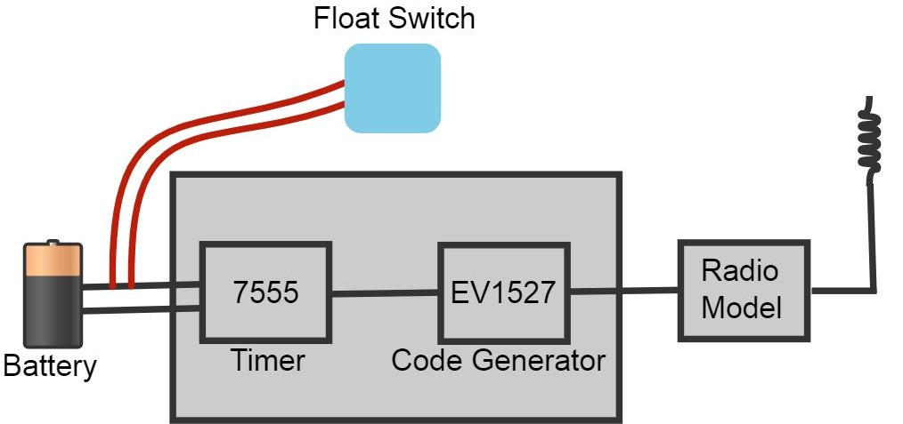
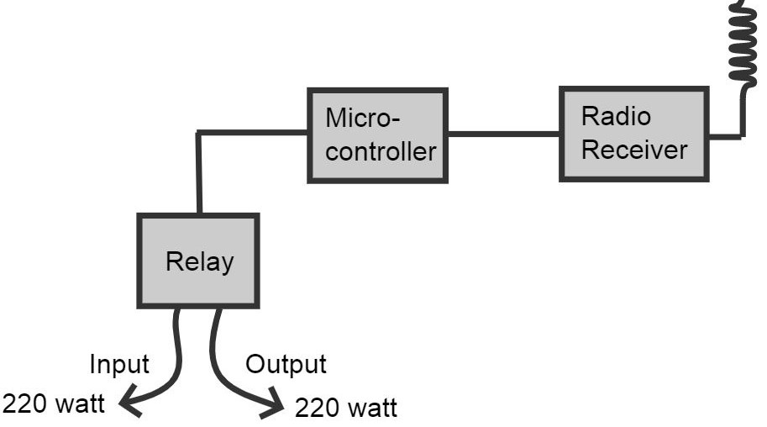

Product Description
Transmitter
Receiver

Slide 7
Components
of the
product

Slide 8
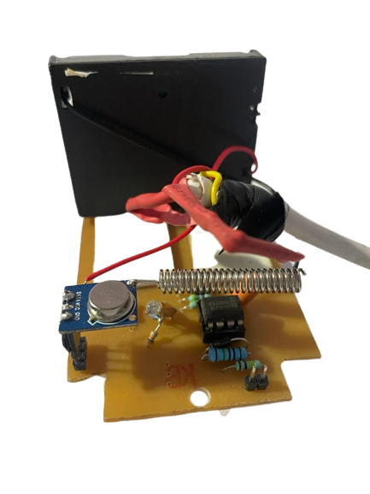
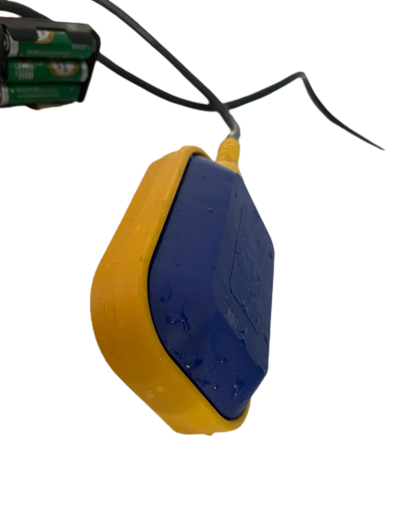
Transmitter
It sends radio signals to receiver in every 30 seconds and indicates whether the tank is full or not.

Slide 9
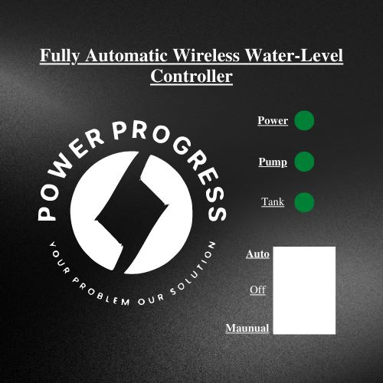
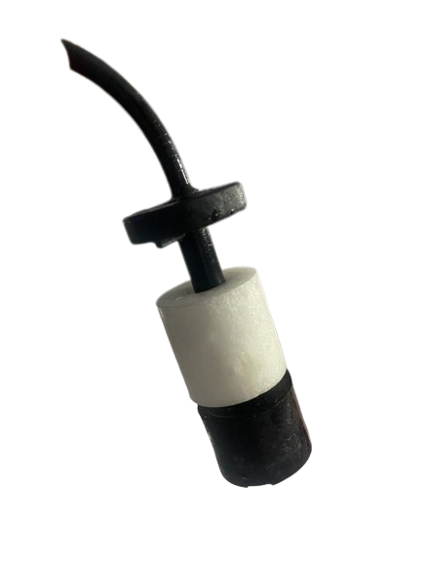
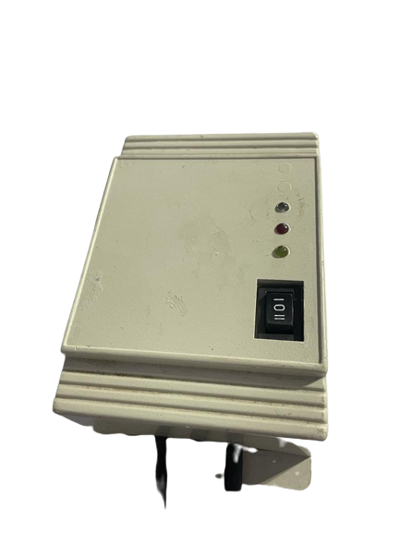
Receiver
It receives signals from the transmitter in every 30 seconds and turns on the motor for 40 seconds until the next signal is received.

Slide 10
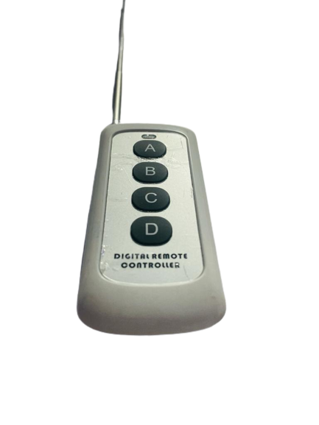
Remote Control
The reach of the remote is upto 300 meters and it can work in a 3 floor building efficiently.

Slide 11
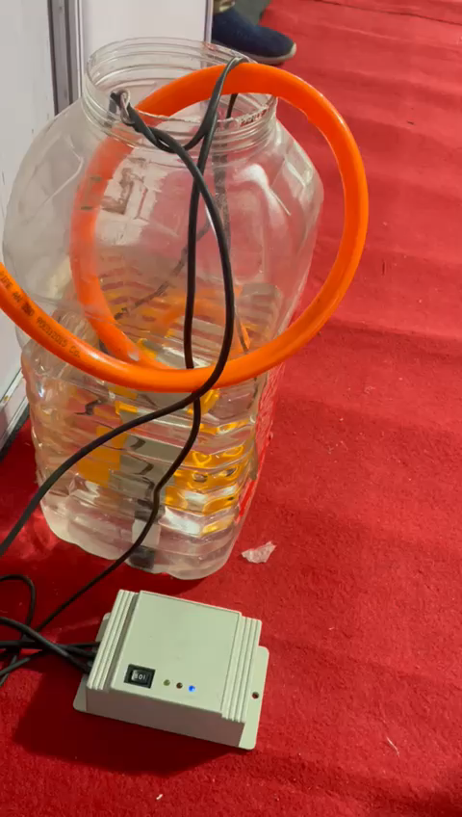
Product video

Slide 12
Key Features
Our product is a wireless product and consumes less power.
It can be controlled from anywhere through remote.
If your tank is full, it automatically gets disconnected with the signal and switch off the motor automatically.
Our product helps to reduce water wastage.
We have used 7555 timer that is a low-power devices that offer significant performance.

Slide 13



Thank You

